Slide 1
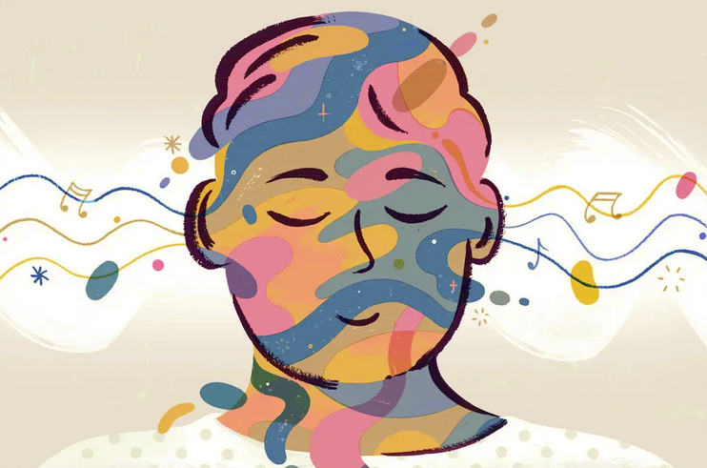
Music and
Mental Health
Group 7
Anders Stachelek
Harini Mittal
Jenny Yu
William Forero
Yoon Young Kim

Slide 2
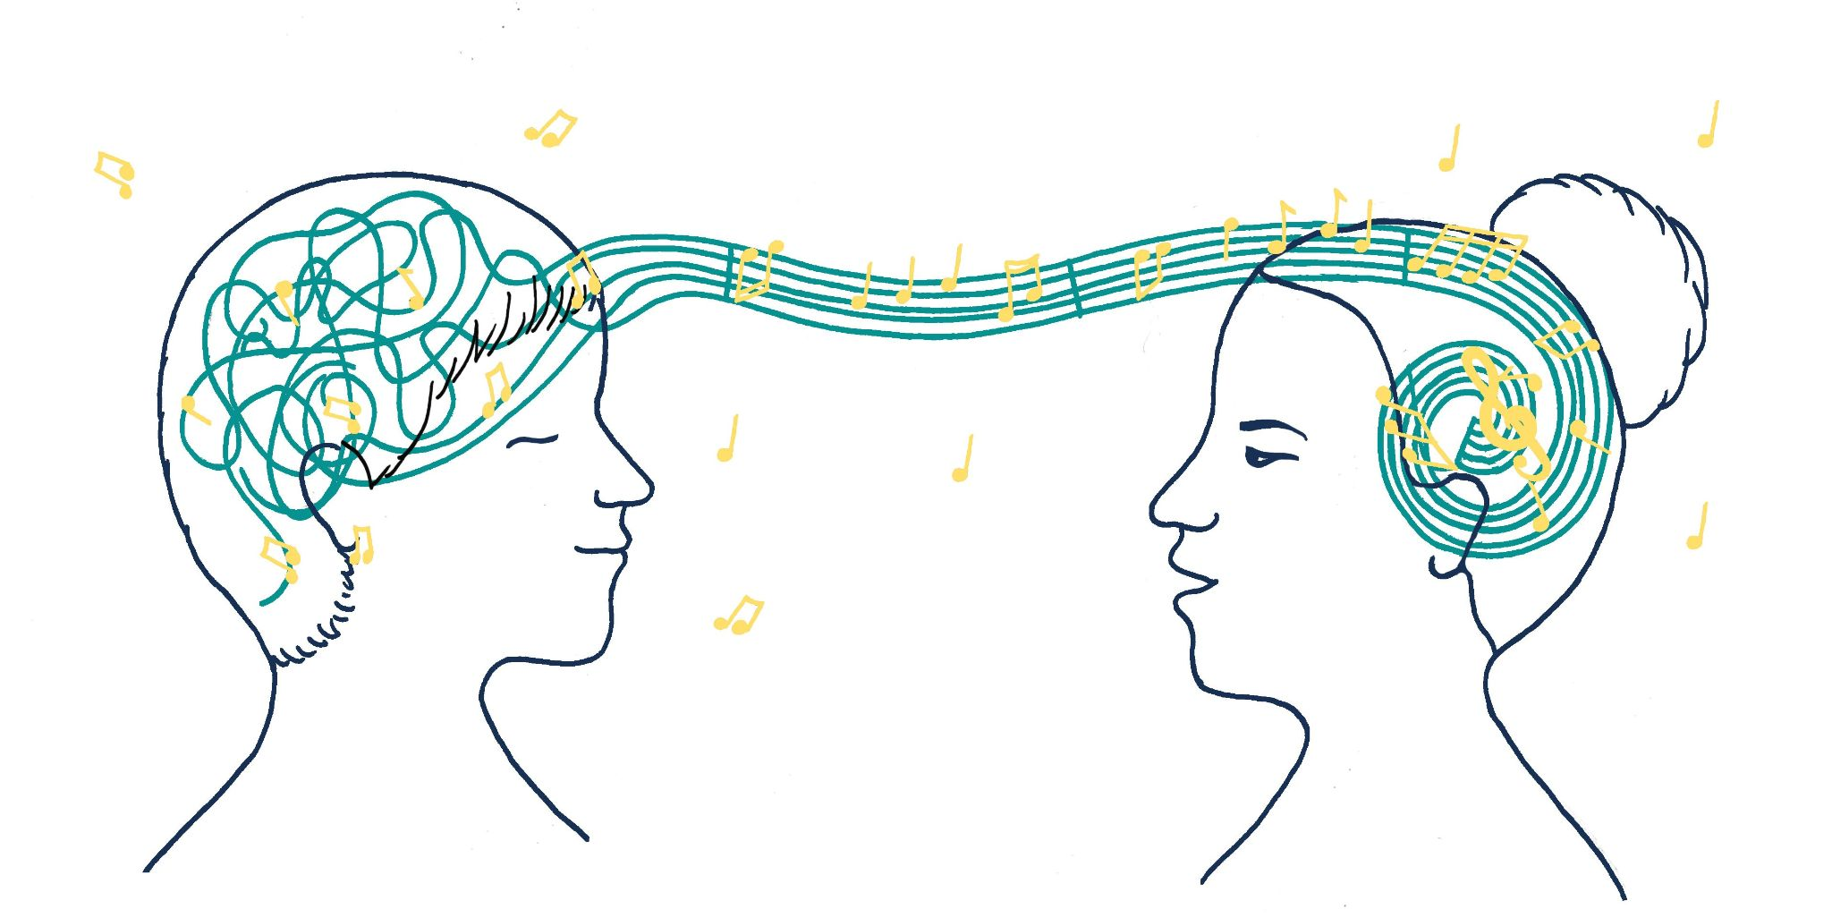
Project Objective
We are a startup specializing in music therapy to address mental health conditions.
Our strategic objective is to establish collaborations with leading music streaming platforms, including Spotify, Apple Music, Amazon Music, and YouTube Music.
Through our analysis, we want to identify the listening patterns of those with mental health disorders. This way, we can collaborate with leading streaming services to develop playlists that can have a positive impact on the well-being of affected individuals.
Notes:
yoon

Slide 3
Our datasets
Primary Dataset - Music and Mental Health Survey
Age
Primary Streaming Service
Hours Per Day
Favorite Genre
BPM
Frequency (16 music genres)
Anxiety
Depression
Insomnia
OCD
Schizophrenia
Bipolar disorder
Eating disorder
Music Effects
Supporting Dataset - Global Trends In Mental Health Disorders
Code
Year (1999-2019)
Anxiety disorders (%)
Depression (%)
Notes:
yoon

Slide 4
Data Cleaning
Step 1: Remove unnecessary columns
Step 2: Remove rows with missing values
Step 3: Remove outliers or illogical values. Focus solely on the years from 1999 to 2019.
Step 4-1: Convert numerical values into categorical values
After cleaning two datasets:
Primary Dataset: 736 obs => 612 observations
Supporting Dataset: 108,553 => 3,724 observations
Categorical Value | Anxiety, Depression, Insomnia, and OCD Scores
High | 8-10
Medium | 5-7
Low | 2-4
No | 0,1
Notes:
yoon

Slide 5
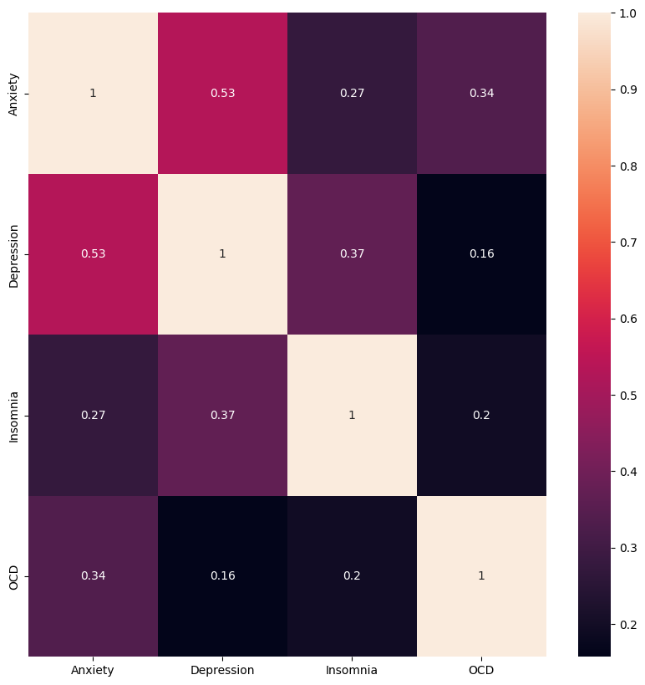
Variables Chosen For Analysis
Correlation matrix of mental health scores
Anxiety
Depression
Favorite genre
Music effects
Primary streaming service
Age
Hours per day
BPM
Frequency
Notes:
jenny-Using jupyter notebook on google colab, we wanted to see if there were any significant correlations between the mental health disorder scores in our primary dataset. As you can see from the correlation matrix, it was clear that anxiety and depression had the highest correlation compared to the others, so we as a group decided to mainly focus on analyzing the patterns between these two. Some other variables we believe would help us in identifying the benefits of music therapy and that may provide interesting insights would be about the individuals favorite genres, the effects of music, whether it improves, does not affect, or worsens their disorder, the primary streaming services used, the age groups and their listening patterns, how many hours one spent listening a day, the beats per minute per genre, and the frequency of listening to a specific genre.

Slide 6
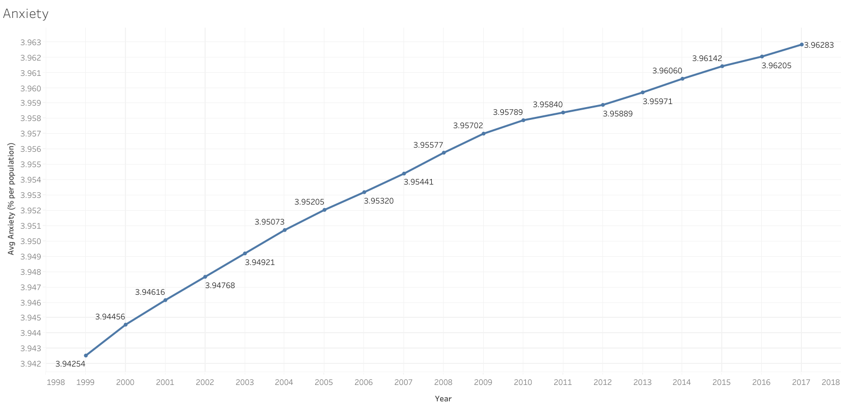
Anxiety Throughout The Years
Notes:
jenny-Next, in our supporting dataset, we looked at the average percentage of the population affected by anxiety throughout the years. We had to adjust the values of the axis to look at the trend more clearly, but we can see that there are slight increases of anxiety worldwide even if the change in the average was so miniscule. From this, we can tell that anxiety has not made much improvement at all and that is why we want to change this with music therapy.

Slide 7
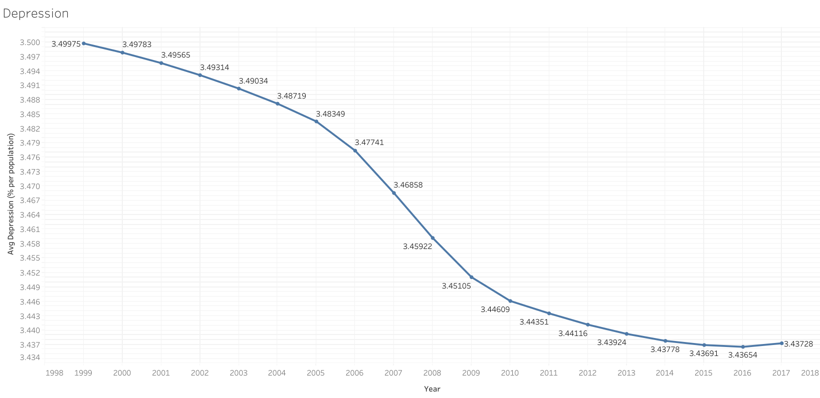
Depression Throughout The Years
Notes:
jenny-Next, we also looked at the average percentage of the population affected by depression throughout the years, and it looks like it was decreasing but again, the change in values was in the hundredth place so it was so small it's hard to say if there was any improvement at all and how it continues to be prevalent all these years.

Slide 8
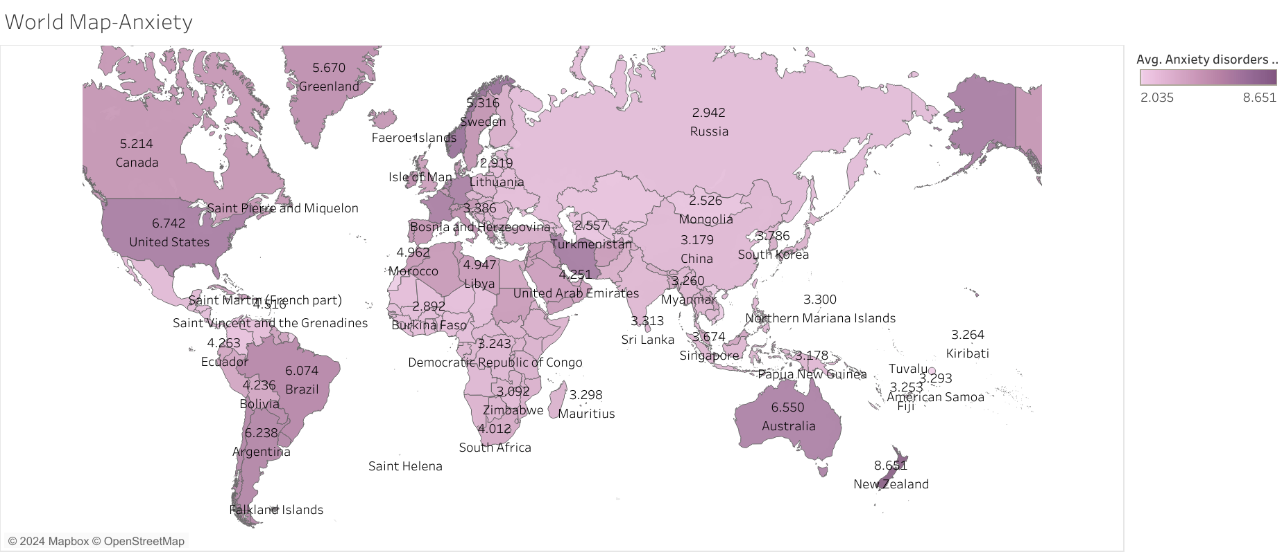
Anxiety Worldwide
Notes:
jenny-Moving on, we wanted to show a world map view of anxiety. The darker the color purple is the more anxious the country’s population is. Some countries that were obvious to point out as the highest were Australia, Argentina, Brazil, United States, Canada, Greenland and New Zealand. With this finding, it tells us how common anxiety is and how many individuals across the world are impacted by it.

Slide 9
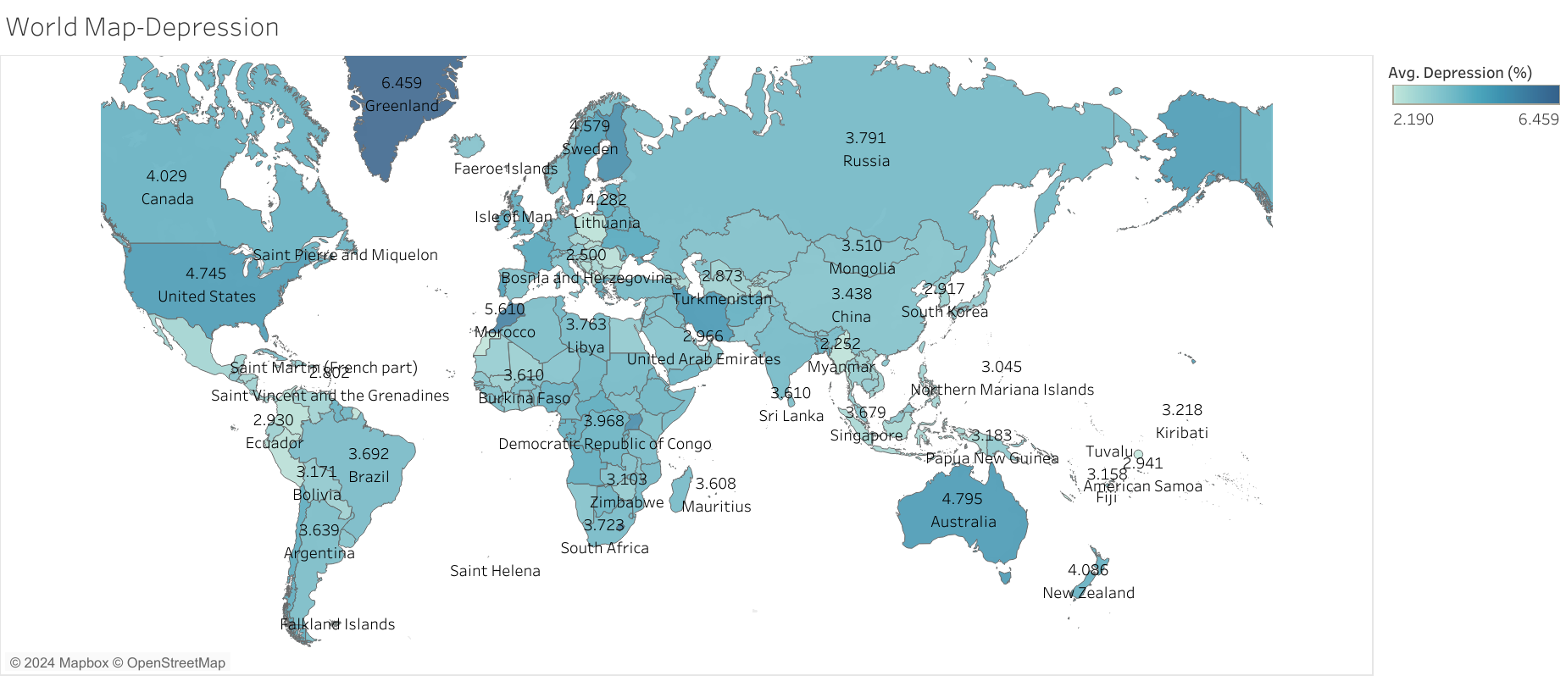
Depression Worldwide
Notes:
jenny-Similarly, we also wanted to see a world map view of depression and again, the darker shade would represent the more depressive country. Interestingly, Australia, Greenland, and the United States, were the countries with high anxiety and here we see they also have high depression. So again, it’s also possible that anxiety and depression have some correlation on a worldwide level and an individual that has anxiety may also experience depression and vice versa and that's why we hope to use music therapy to help those affected.

Slide 10
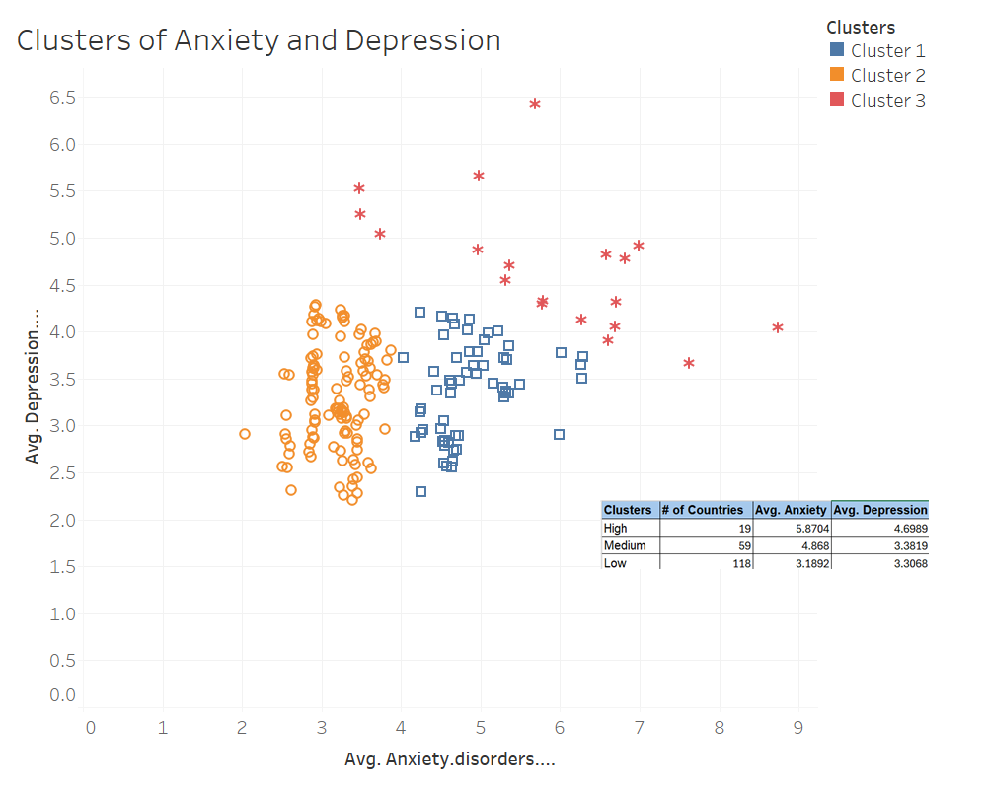
Global Clusters of Anxiety and Depression
We can see three clusters of anxiety and depression similar to the first database - High, Low and Medium
Notes:
harini-Therefore, we can use the findings of our data visualization exerThe second database comprising global trends of mental illnesses also shows 3 clusters of anxiety and depression with average percentage of population in those regions. cise and apply them to reach out to global markets. Of the 196 countries, we can see 19 countries are in the high anxiety/depression cluster, while 59 are in the medium cluster and 119 are in the low anxiety/depression cluster.

Slide 11
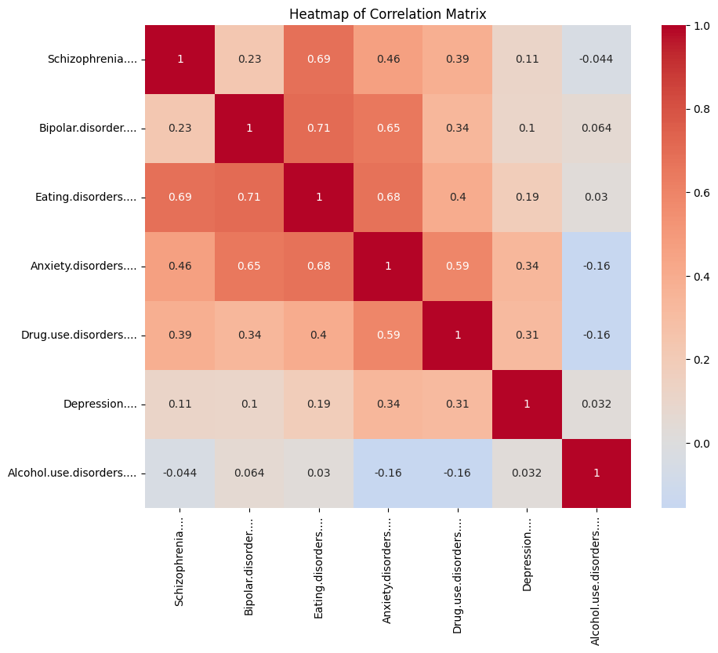
Global trends in mental disorder interrelationships
Worldover, anxiety disorder is correlated with schizophrenia, bipolar disorder, and eating disorder.
Notes:
harini-This shows that there is potential to reach out to a broader population who have such other disorders as well, with the same or similar genre, BPM, and timed playlists. Now we present the impact of music therapy on mental health analyzing various dimensions such as duration of music listening, preferred music types, tempo, and platform preferences and how they correlate with specific mental health issues

Slide 12
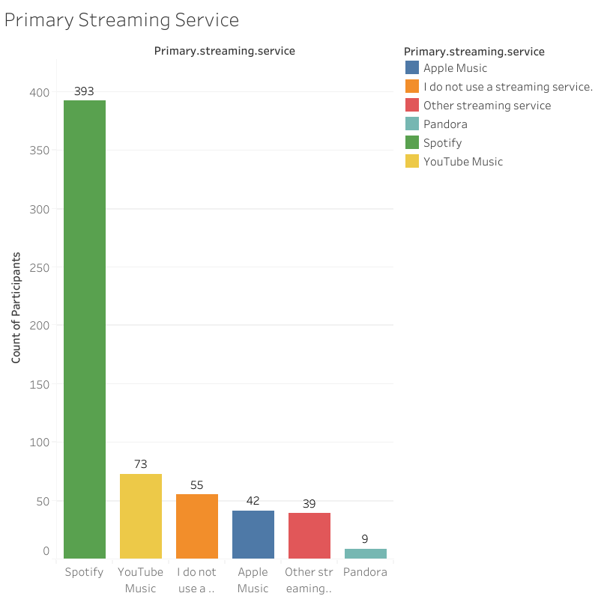
Primary Streaming Services Used
Spotify is the top music streaming service used among the participants.
Notes:
jenny-So we also analyzed the primary music streaming services used and the obvious winner here is Spotify and that is why we are aiming to collaborate with them to create specific playlists most suitable for individuals that experience anxiety or depression.

Slide 13
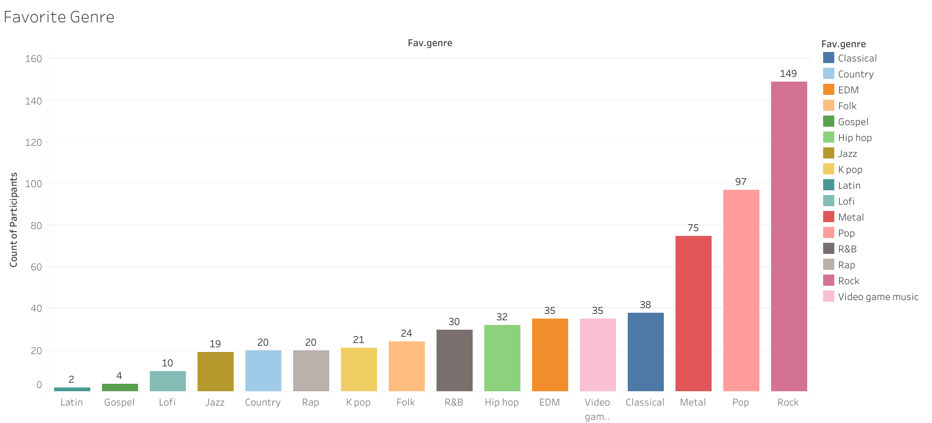
Favorite Genre
Notes:
jenny-Next, now that we have decided to focus on the disorders of anxiety and depression, let’s see the other variables that will help with our analysis. For genre, our dataset measured 16 different genres that were reported by the participants and from this bar chart, we can see that the top genres reported are Rock, Pop, Metal, and Classical. However, this doesn’t necessarily mean these genres have a positive impact on mental health, so let’s go more in depth with the analysis of genre along with other variables.

Slide 14
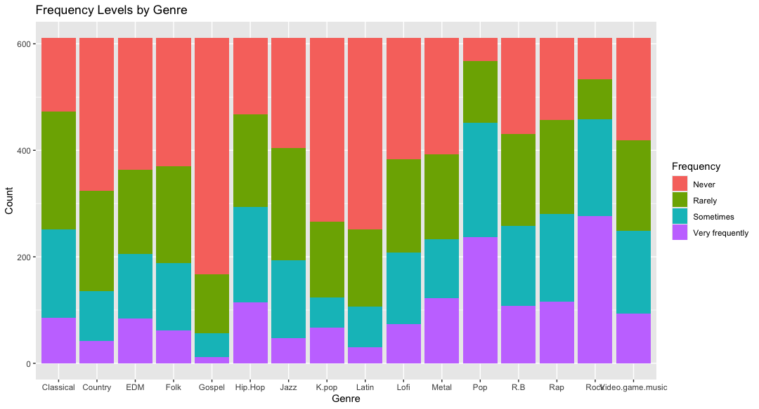
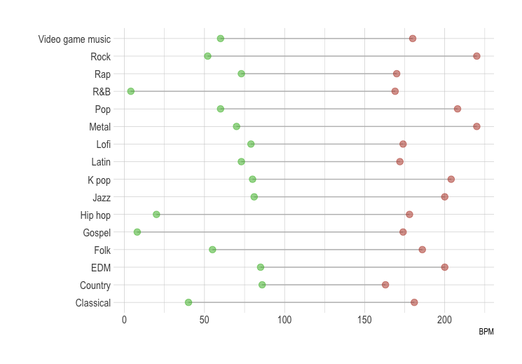
Genre Analysis
Notes:
yoon

Slide 15
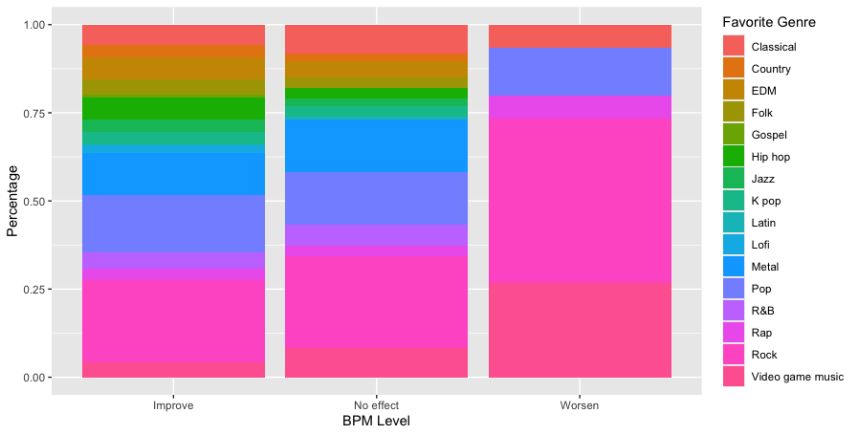
Genre and Music Effects
Our recommended music playlist aims to provide a supportive selection for those managing mental illness.
We prioritize genres such as Country EDM, Folk, Gospel, Hiphop, Jazz, Kpop,Latin, Lofi, and Metal while avoiding or minimizing exposure to Classical, Pop, Rap, Rock, and Video game music.
Notes:
yoon

Slide 16
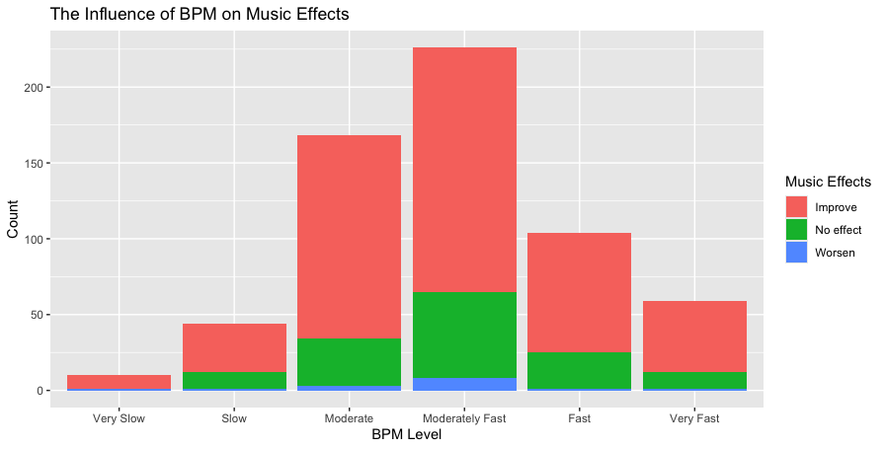
BPM and Music Effects
BPM classification | BPM | Examples
Very Slow | Below 60 | Funeral dirges, some ambient music, extremely slow classical pieces.
Slow | 60-80 | Ballads, slow waltzes, some jazz standards.
Moderate | 80-110 | Pop songs, rock ballads, folk tunes, many jazz tunes.
Moderately Fast | 110-140 | Upbeat pop songs, rock songs, some EDM tracks, faster jazz standards.
Fast | 140-170 | Dance music, techno, punk, some rock and pop songs with high energy.
Very Fast | Above 170 | Speed metal, hardcore techno, drum and bass, some extreme forms of electronic music.
Notes:
yoon

Slide 17
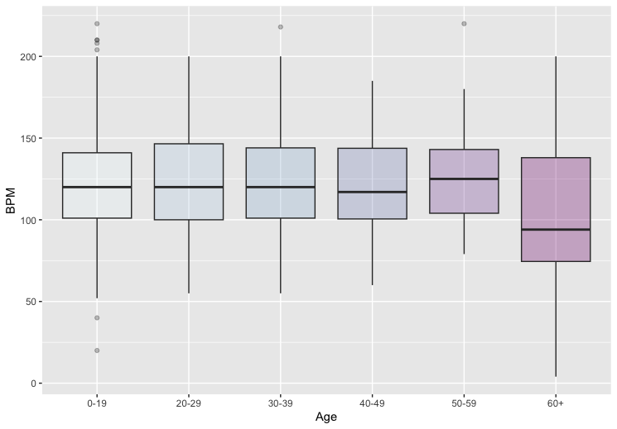
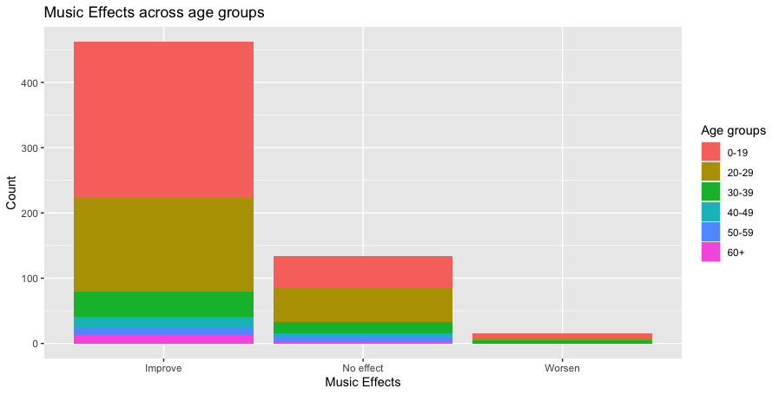
Age Group Analysis
Notes:
yoon

Slide 18
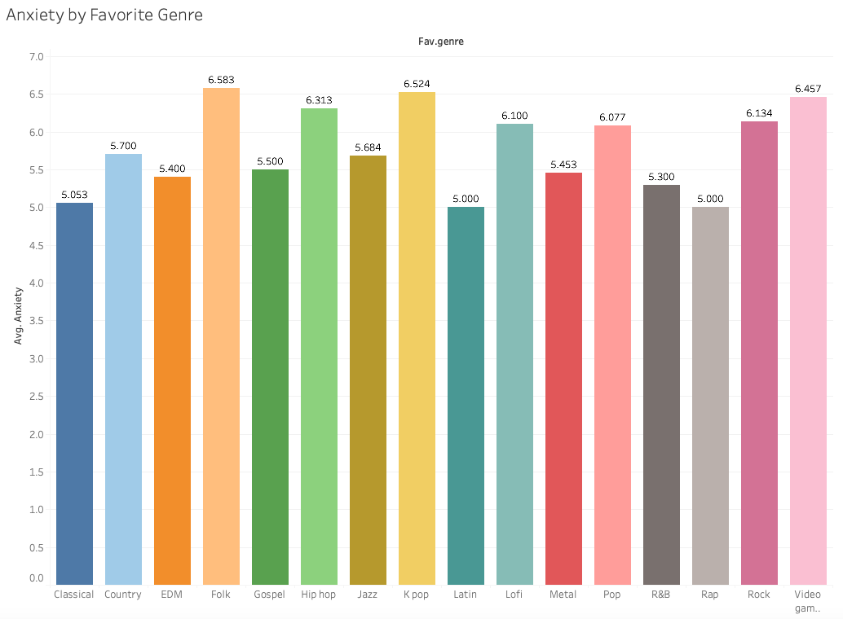
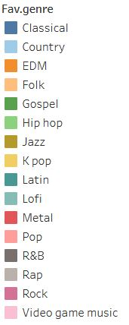
Music Effects and Favorite Genre (Anxiety)
Individuals that reported Folk, K Pop, and Video Game music as their favorite genre reported higher levels of anxiety on average.
Those that reported Latin, Rap, and Classical as their favorite genre had lower levels of anxiety on average.
Notes:
william

Slide 19
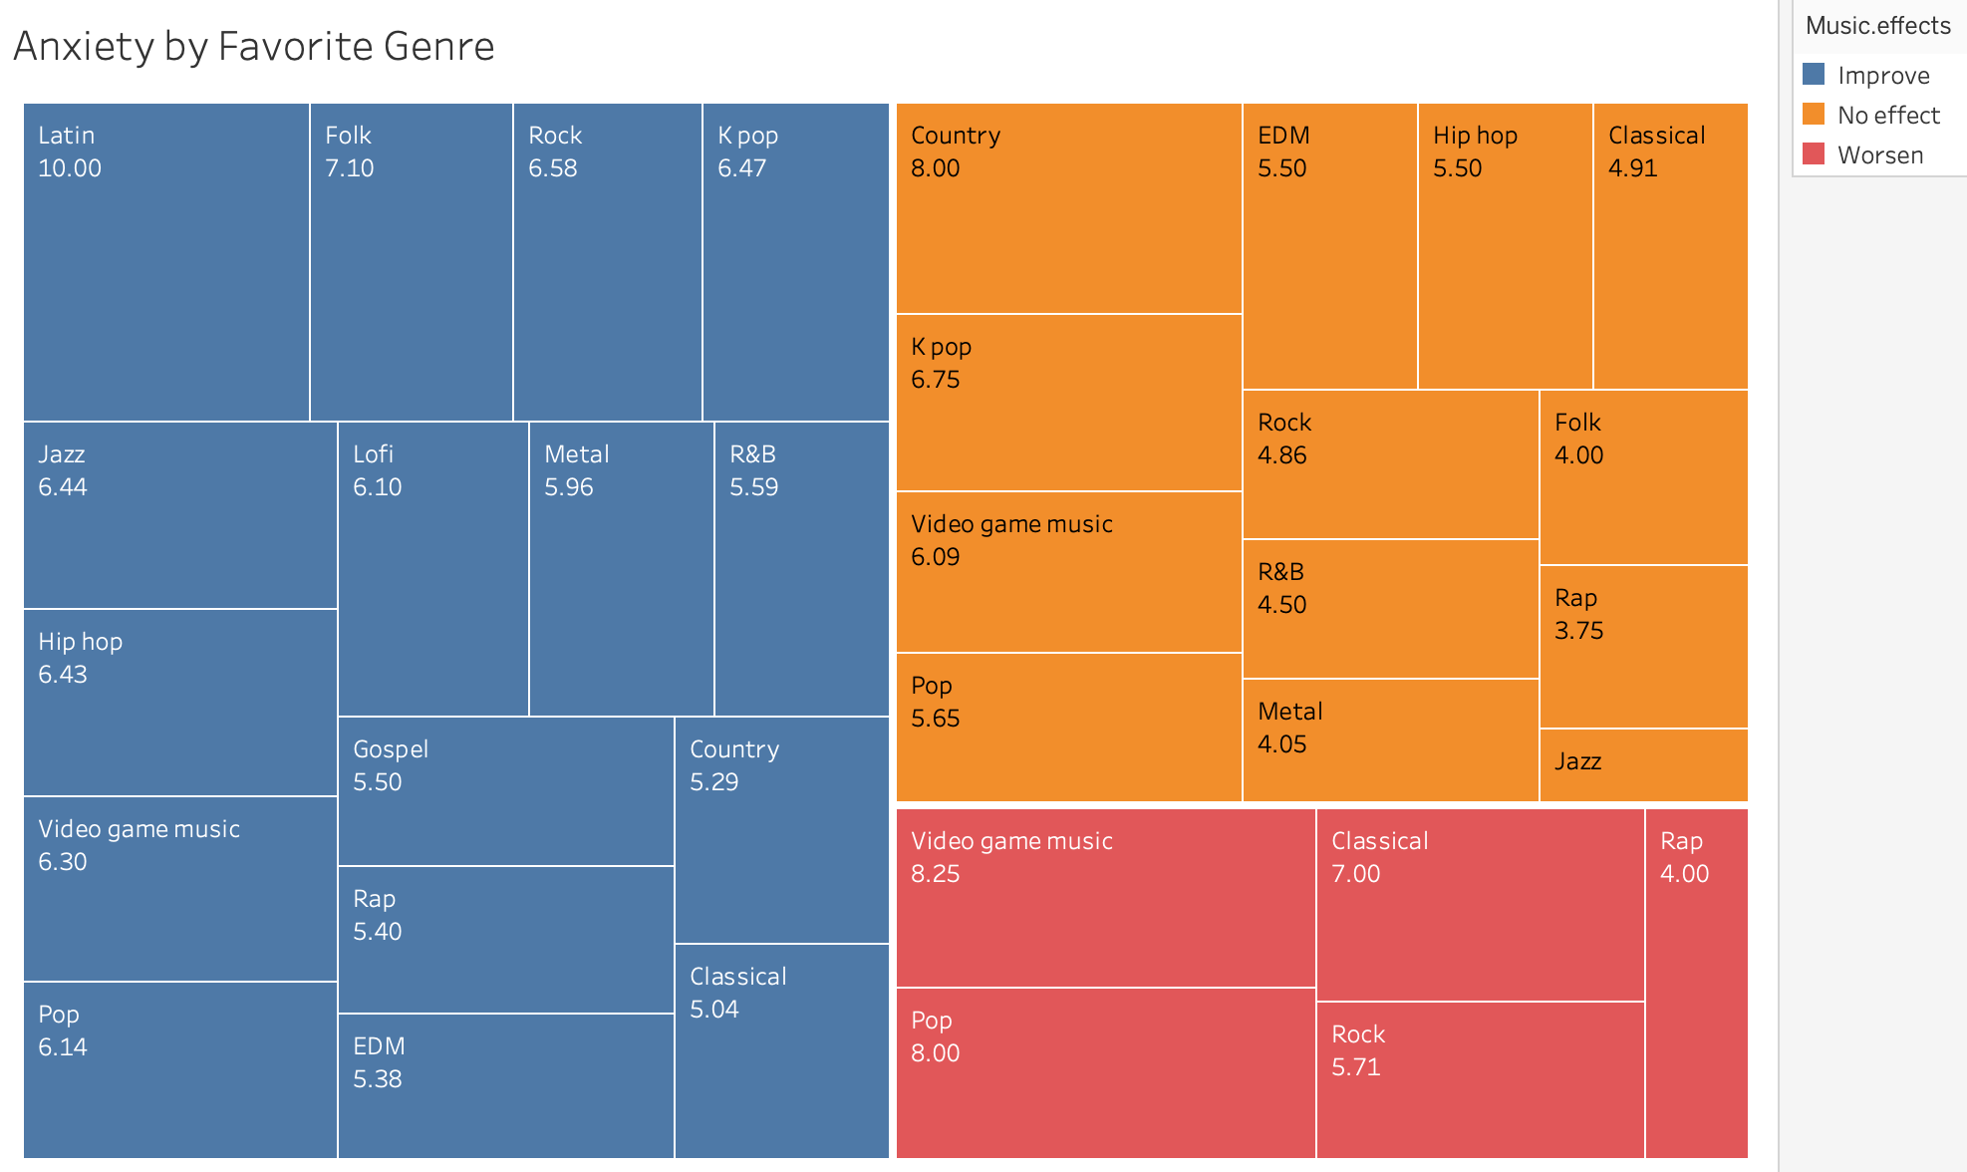
Music Effects and Favorite Genre (Anxiety)
Adding in the reported music effects, individuals that listed Classical, Pop, and Video Game music as their favorite genre reported higher levels of anxiety on average and experienced that Music worsened their conditions.
Notes:
william

Slide 20
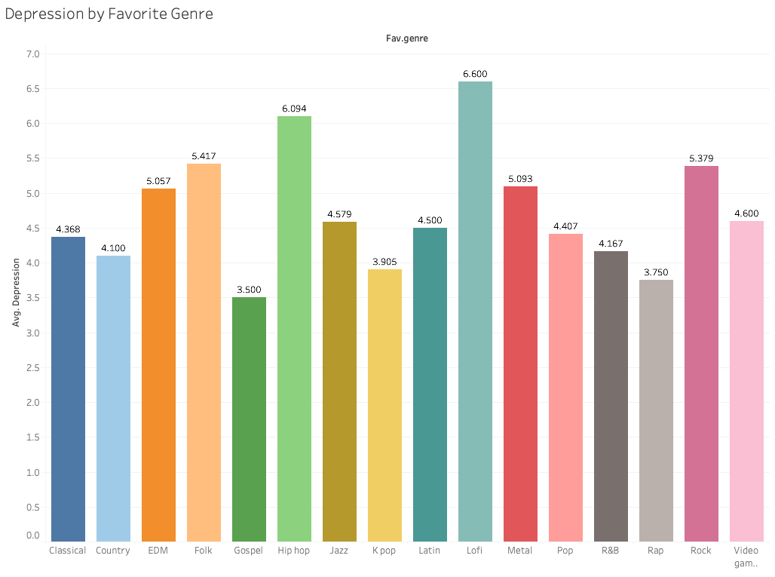
Music Effects and Favorite Genre (Depression)
Individuals that reported Lofi, Hip Hop, and Folk music as their favorite genre reported higher levels of depression on average.
Those that reported Gospel, Rap, and K Pop as their favorite genre had lower levels of depression on average.
Notes:
william

Slide 21
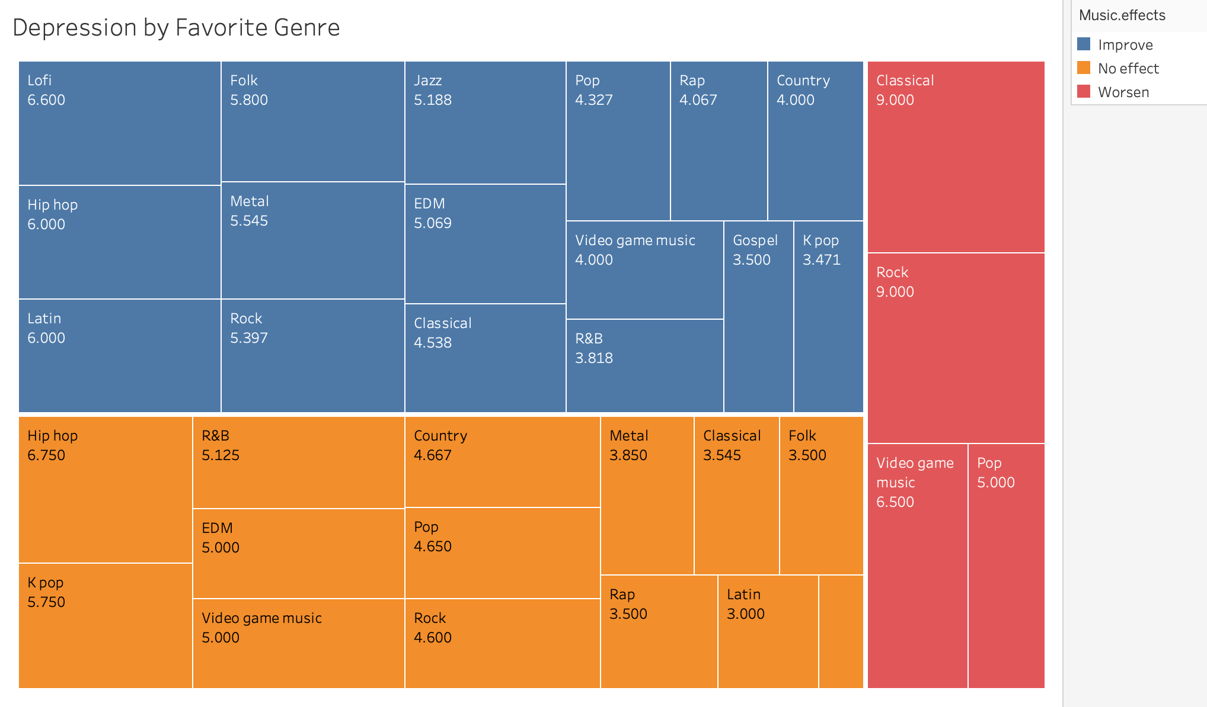
Music Effects and Favorite Genre (Depression)
Adding in the reported music effects, individuals that listed Classical, Rock, and Video Game music as their favorite genre reported higher levels of depression on average and experienced that Music worsened their conditions.
Notes:
william

Slide 22
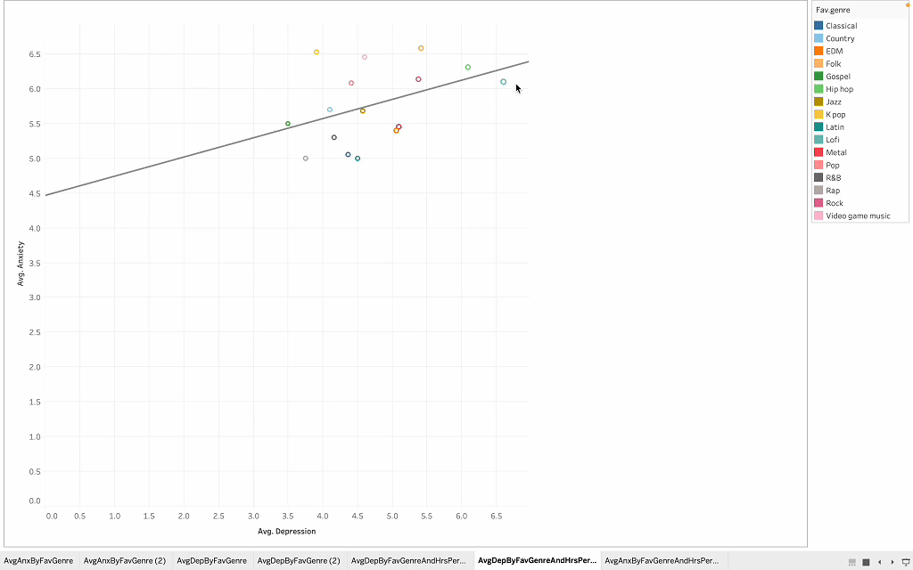
Music Effects and Favorite Genre
Notes:
william

Slide 23
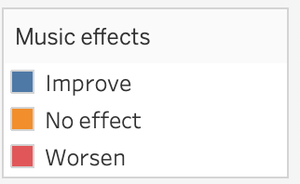
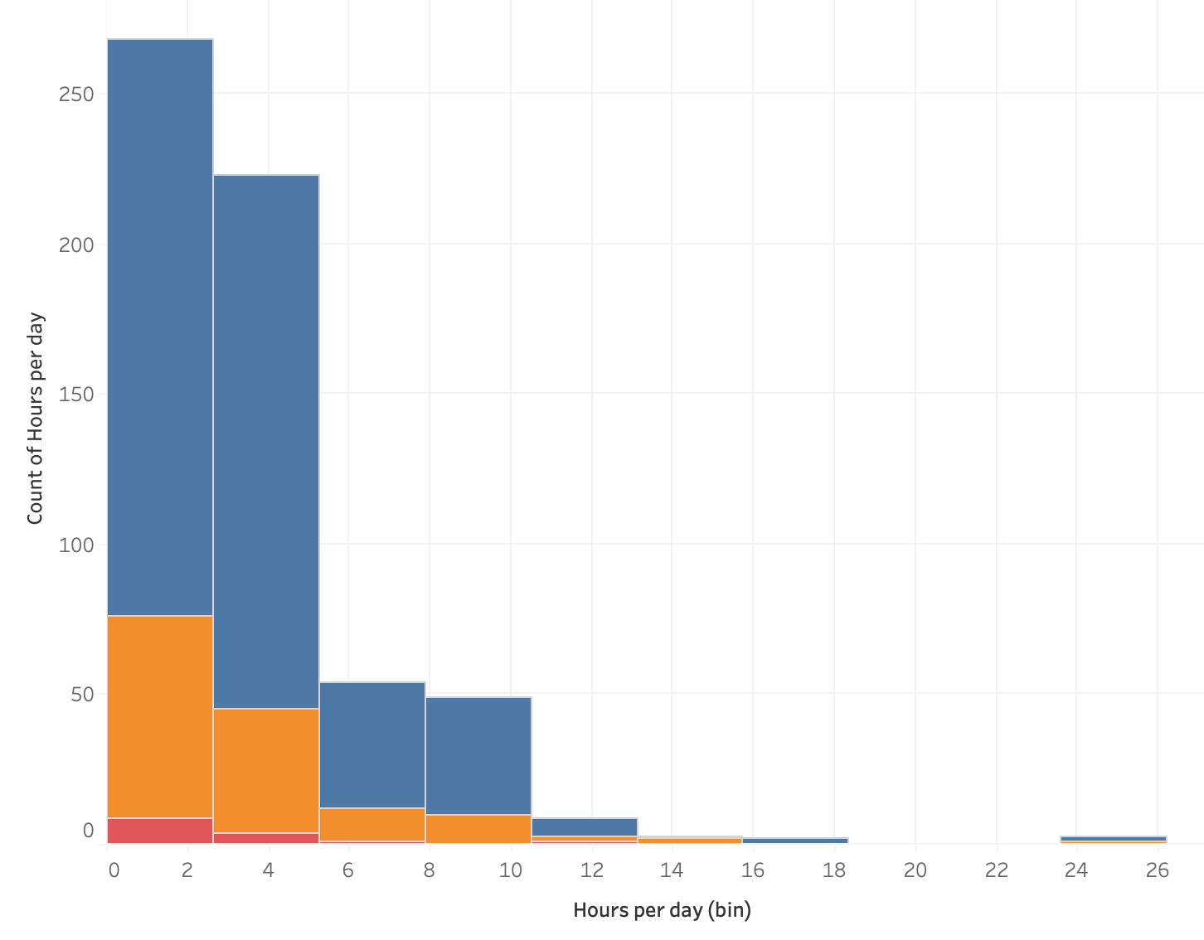
Hours Listening to Music
Based on the survey data, it is clear that a substantial number of individuals typically listen to some music daily, with most participants listening between 1 and 4 hours a day (about 70%). Therefore, the interactions between hours of listening and anxiety, depression, and music effects became an important area of analysis.
Would increasing the hours of listening to music help combat depression and/or anxiety?
Notes:
AJ- Thank you William. The next analysis we conducted relates the hours of listening to music to the effect music has on mental health. Overall, we found that listening hours are heavily skewed to the right due to the fact that about 70% of the survey respondents listen between 1 to 4 hours a day, and a few reported much higher values. For people who stated music worsens their anxiety and depression, they also reported lower hours of listening to music. Perhaps recognizing that music increases anxiety and depression leads to them avoid music, so perhaps a different playlist may alter this negative effect and increase listening hours. What is reassuring is that most survey participants stated that listening improves their mental health, further supporting the need for our platform.

Slide 24
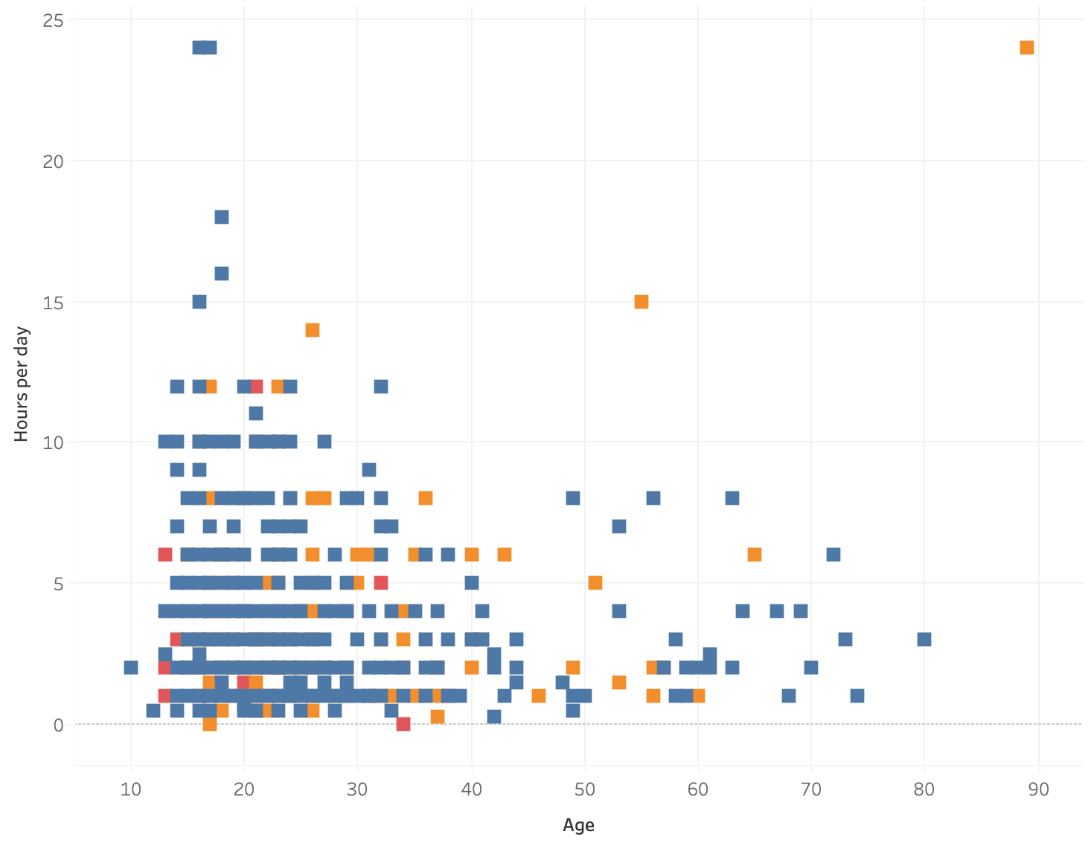
Hours Listening to Music by Age
We also wondered if listening to music differed across age. As this visualization shows, older individuals tend to listen to fewer hours of music; however, what little they listen to is not seen as detrimental to their mental health. In fact, those who see music as detrimental to their mental health are below 35 years old with the most being teenagers.
Notes:
AJ- Next we compared hours of listening to the age of surveyed participants. We noticed that younger people tend to listen to more hours of music, while older people listen to fewer hours. Specifically, individuals greater than 35 years of age report that music either has no effect on their mental health or improves it. We recognize that there is an opportunity to market to people 35+ and older to increase usage of our streaming platform geared towards promoting mental health and wellness. Because we noticed skewness in these two visualizations, we decided to use the median value of hours listening to music for the rest of the analysis of this variable.

Slide 25
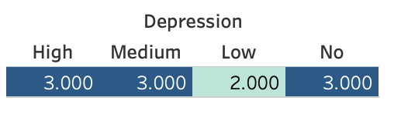
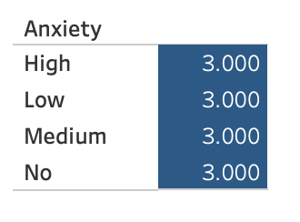
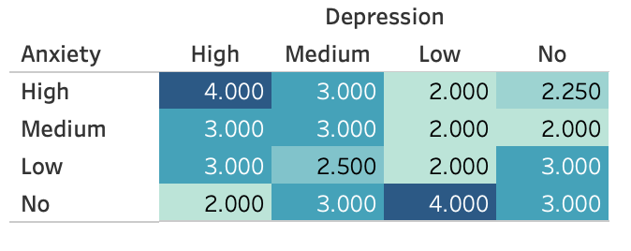
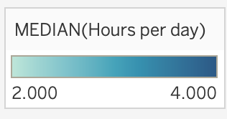
Hours Listening to Music and Mental Health Scores
The following tables allow one to focus on how many hours do individuals typically listen to music (using the median) and sorts these values by their respective rates of depression and anxiety. Separately, depression and anxiety do not have clear differences in listening time, while contingent on each other, they do.
Notes:
AJ- Using highlighted tables, we first started looking at mental health categories separately. We noticed that neither depression or anxiety seem to elicit any pattern across the various levels in relation to the hours listening to music; however, when we related the levels of anxiety to the associated levels of depression, we noticed that individuals with high anxiety and depression have the highest median hours of listening to music. It is important to note that those with no anxiety and low depression also have the highest median hours listening as well; however, by focusing on the group that are high in both anxiety and depression, we can see that there is a strong market for streaming platforms as these individuals already report higher listening hours.

Slide 26
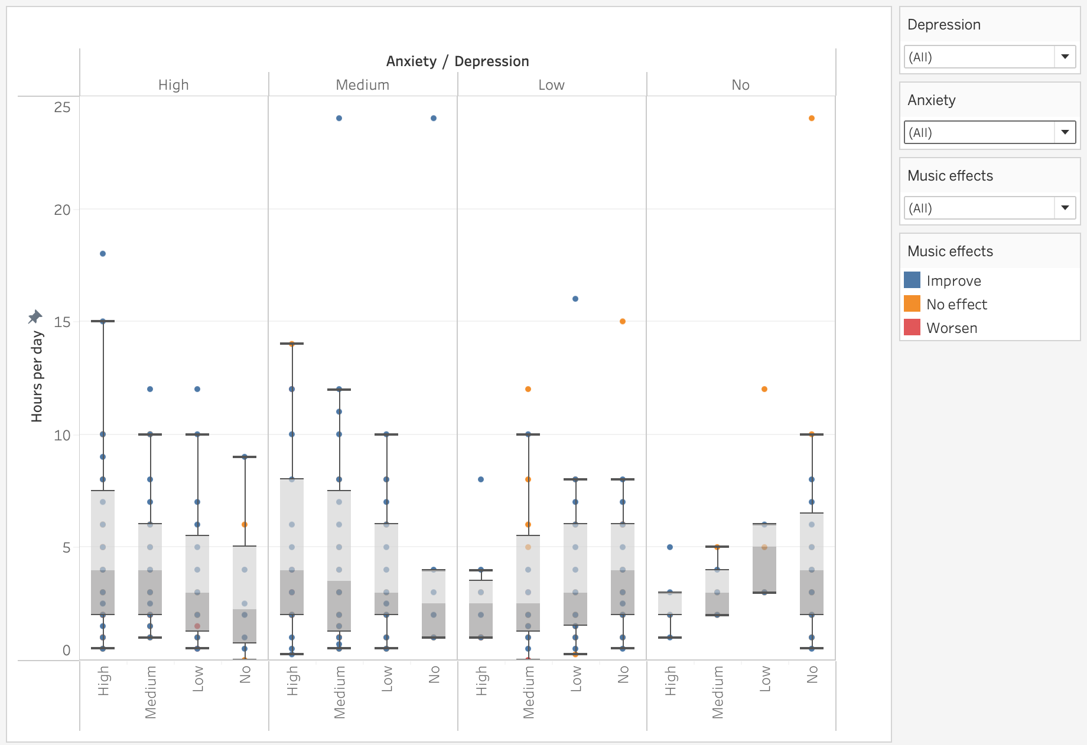
Hours Listening and Anxiety & Depression w/ Music Effects
Notes:
AJ- When we combined all of the information on the various levels across anxiety and depression, the hours individuals listen to music, and the self-reported effects music has on such mental health disorders, we found that high and medium levels of anxiety are often related to higher overall hours of listening to music; however, this visualization only tells part of the story, as the musical effects are hard to decipher across so many categories.

Slide 27
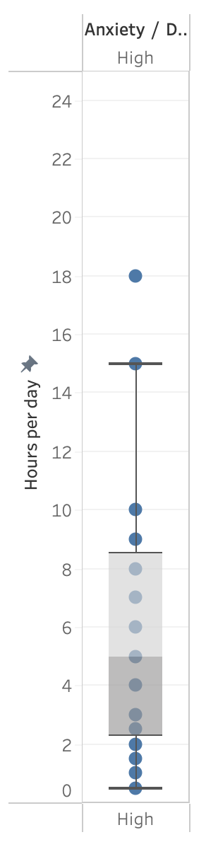
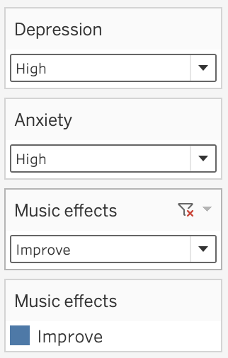
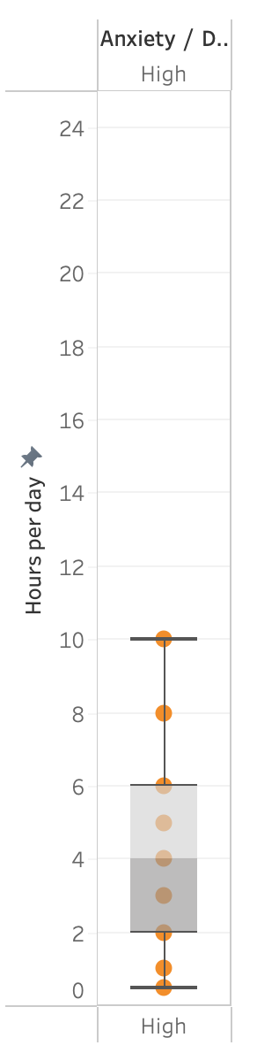
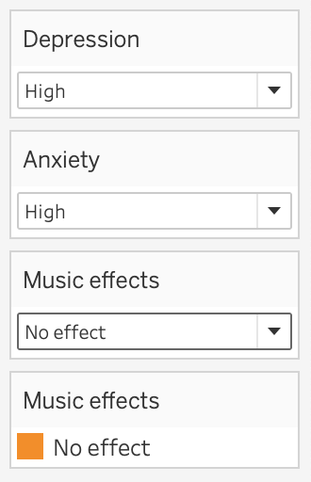
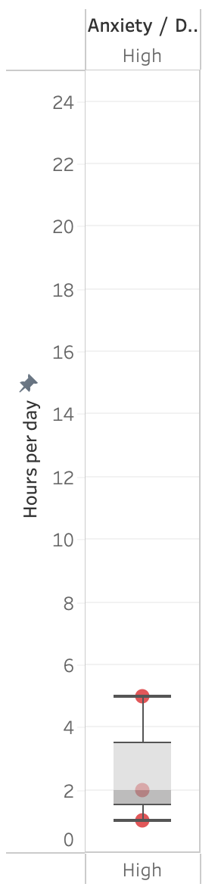
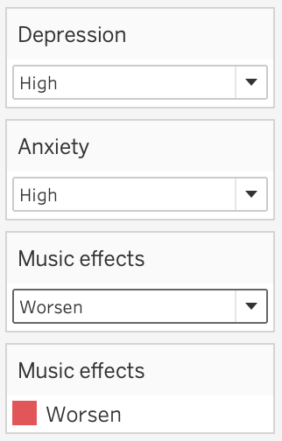
Hours Listening and Anxiety & Depression w/ Music Effects
Notes:
AJ- By narrowing our focus to the intersecting categories of high anxiety and high depression and filtering across the effects music has on mental health, our findings become more striking. People who reported improved mental health through music also report higher hours of listening to music, while the group reporting a worsening effect report a much lower number of hours. Because the data comes from a survey, it is unclear whether this result is due to the experience of the effect of music on mental health or the reason behind the number of hours someone chooses to listen to music.

Slide 28
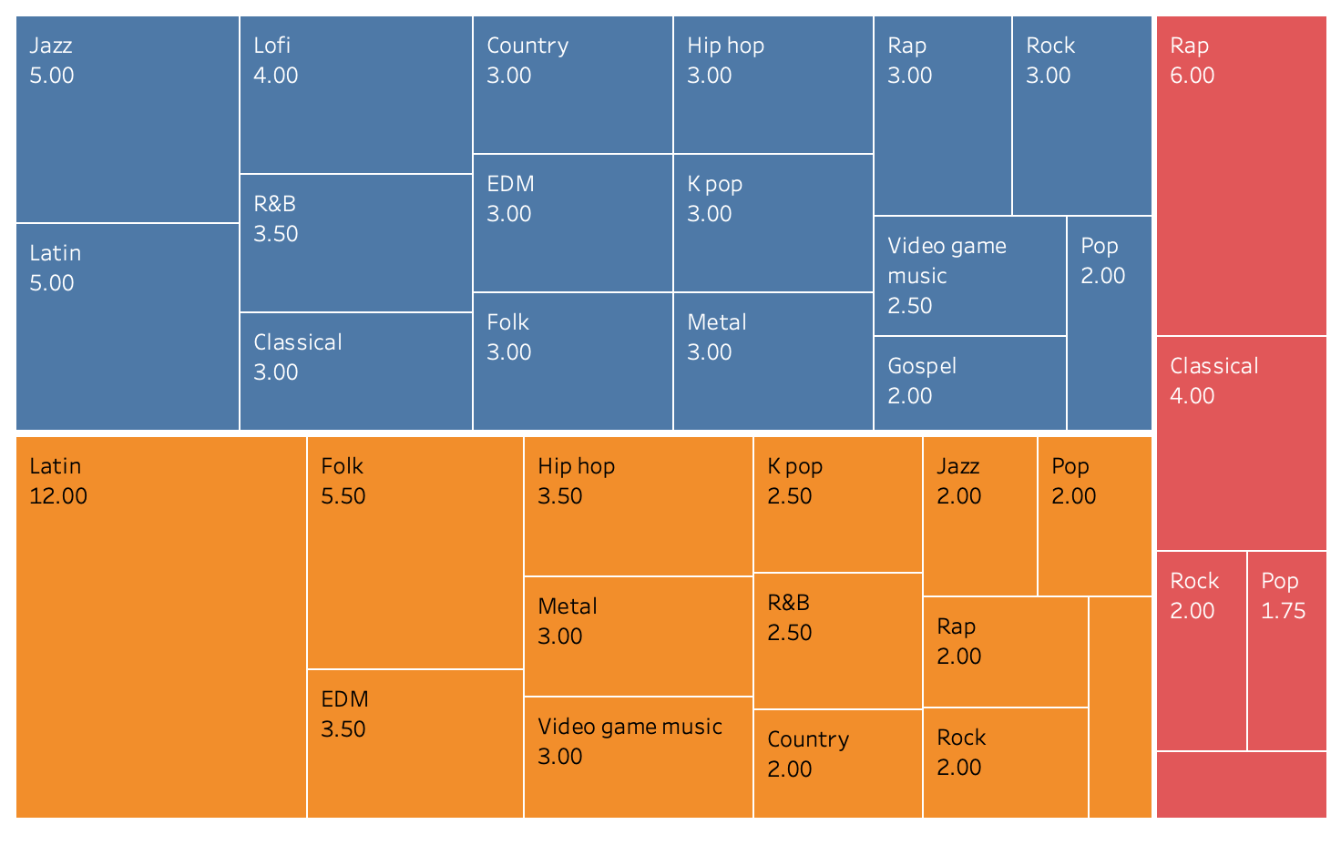
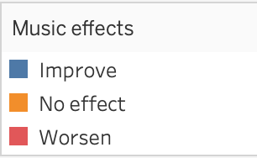
Hours of Listening by Genre and Music Effects
This tree diagram shows the number of hours listened (using median) with favorite genres and the effect music has on the individuals surveyed.
It appears that Rap is a genre that might be best minimized for individuals experiencing high levels of anxiety and/or depression.
Notes:
AJ- Lastly, we looked across favorite genres to see if there is any relationship between music effects and the hours listening to music across genres. We noticed that rap and classical appear to have the highest number of listening hours in the worsen category, which even exceeds their neutral or improved categories. These findings suggest that it may be best to avoid genres like rap and classical; although again, these results are from a survey snapshot in time and do not allow us to claim causation between the music effects on mental health and the favorite genre and hours listening to music. I will now pass it on to Harini for our conclusions and key takeaways.

Slide 29
Conclusions and Key Takeaways
Most prevalent mental illnesses are anxiety and depression, and they are interrelated.
No change in the prevalence rates of these diseases over the past few years based on the survey data from 196 countries.
Individuals with high anxiety and depression demonstrate a higher engagement with music.
Music Therapy has positive effects on mental health.
Interdependence of depression and anxiety highlights a significant trend in hours spent listening to music.
Notes:
harini

Slide 30
Conclusions and Key Takeaways
Most survey participants listen to music 1 to 4 hours daily and report mental health benefits.
Most participants reported listening to music in the “Moderately Fast BPM” category.
Overall improvement in mental well-being was observed across all BPM classifications.
Respondents who favor Folk, K-pop, and Video Game Music reported higher anxiety levels: unclear if the music causes this or if anxious individuals prefer these genres.
Specific genres of music improve mental well-being.
Notes:
harini

Slide 31
Music Therapy Intervention Plans for Mental Well-being
Strong market potential for streaming platforms targeting individuals with high anxiety and depression as their engagement with music is high.
Create playlists to alleviate mental illness, focusing on genres like Country EDM, Folk, Gospel, Hiphop, Jazz, Kpop,Latin, Lofi, and Metal: minimize exposure to Classical, Pop, Rap, Rock, and Video game music.
Create age-tailored playlists: Different age groups have different musical preferences.
Need for optimized playlists on streaming platforms for individuals with worsened anxiety and depression from music, because they tend to listen less.
Run an experiment - have participants listen to music and rate their overall mental health based on the experiment to reconfirm our strategy.
Notes:
harini

Slide 32
Future Market Potential
All over the world, three other major mental illnesses, schizophrenia, eating disorder, and drug-use disorder are related to anxiety.
Any solution that will improve anxiety and depression, can possibly help those with the other three major disorders as well.
Accordingly, we plan to offer data insights to our streaming platform partners to provide targeted music playlists in a phased manner.
Notes:
harini

Slide 33
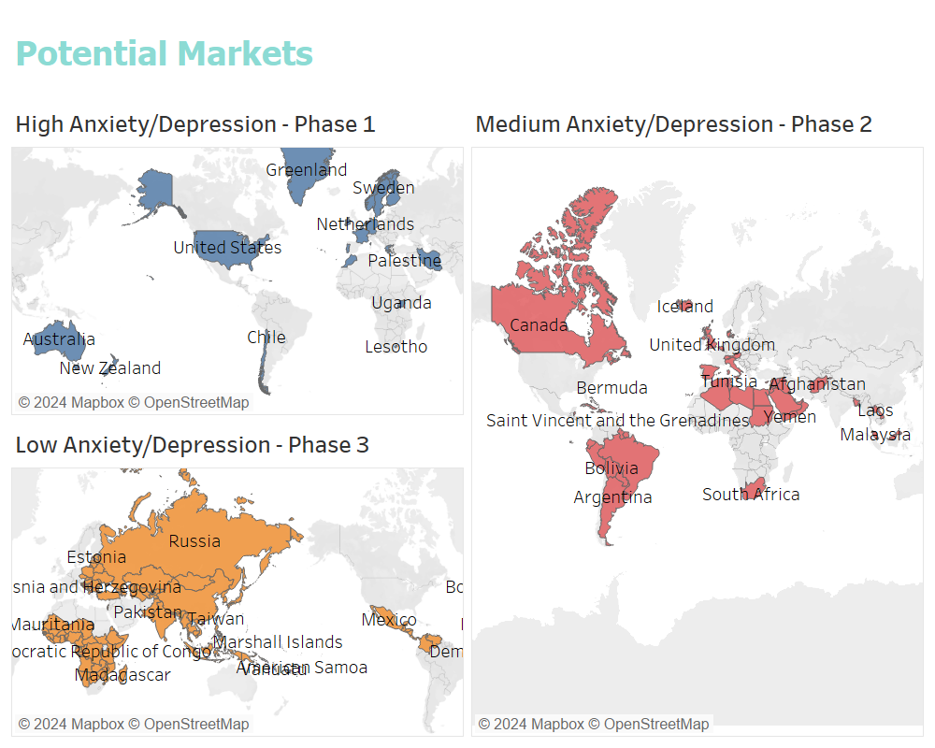
Notes:
harini-Accordingly, we plan to offer data insights to our streaming platform partners to provide targeted music playlists in a phased manner. In phase 1 we will target the 19 high anxiety countries, in phase 2 we will extend our services to medium anxiety countries, and in phase 3, to the rest of the world.

Slide 34
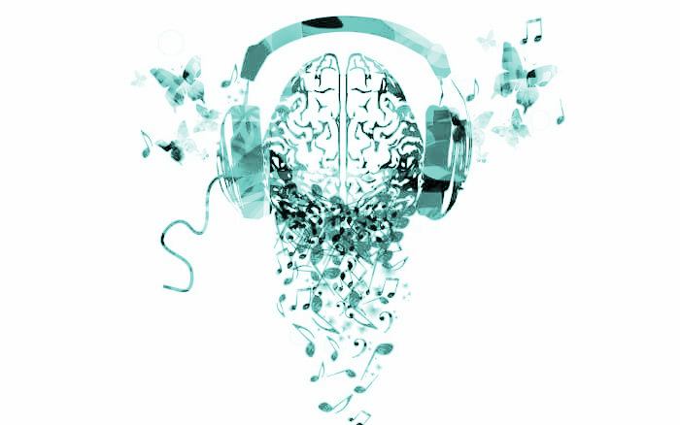
THANK YOU!
Notes:
harini

